Slide 1
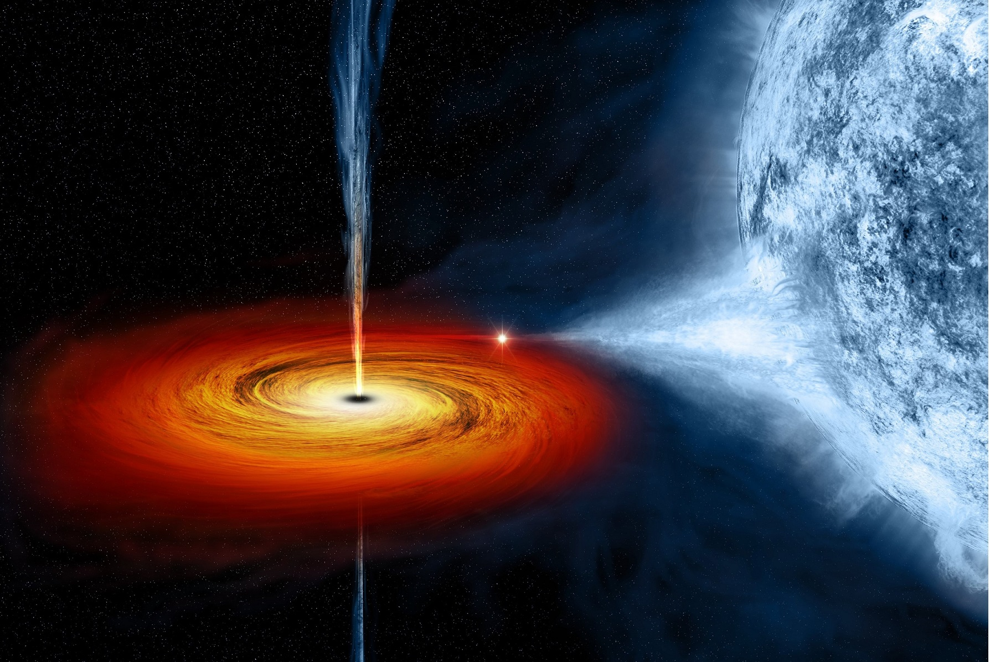
Variable Stars
Pavol A. Dubovský
AAM
Funchal 2019

Slide 2
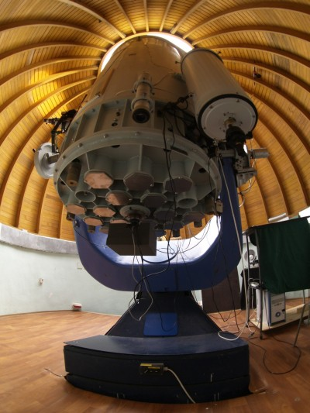
Introduction
Pavol A. Dubovský
Vihorlat Observatory, Slovakia
Variable star observer
70 000+ visual observations since 1998
6600+ CCD lightcurves constructed
250+ spectra acquired
100+ papers in refereed journals published
Membership: Slovak Astronomical Society, Slovak union of Astronomers,
Associação de Astronomia da Madeira
Web: var.kozmos.sk

Slide 3
An Overview
I want to answer three questions today
What are variable stars?
Why do we care about variable stars?
How can you help contribute to science by observing variable stars?

Slide 4
What are stars?
Massive object, typically comprised of mostly Hydrogen gas
Balancing act between gravity’s contraction and nuclear burning’s expansion
Mass is the most important quantity of a star
Initial mass determines its life cycle

Slide 5
What are variable stars?
Stars that vary in brightness
Some vary before our eyes, in minutes, to hours, to days
Some vary over hundreds of days to years
Some vary in a smooth cyclical manner
Some will suddenly and unpredictably fade
Some erupt violently only once every million years!

Slide 6
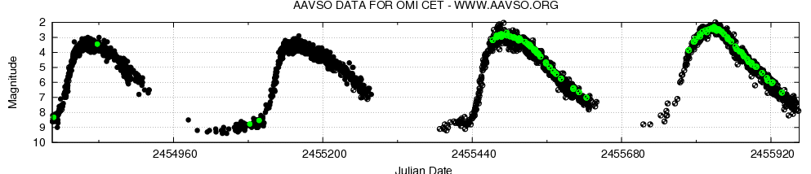
Light Curves
Graphical representation of the brightness of the star as a function of time
Vertical axis is brightness - brighter at the top, fainter at the bottom
Horizontal axis is time from left to right, usually in days

Slide 7
Variable star names
Classical variable star nomenclature, names begin with R for the first discovered star in a constellation, such as R Leonis.
Proceed through the alphabet R-Z, then RR, RS, RT to ZZ, then back to AA, AB to QZ.
After the letters are exhausted they are numbered V335, V336 and so on…
The year 2011 nova, V5588 Sgr, is the 5,922nd named variable in Sagittarius!

Slide 8
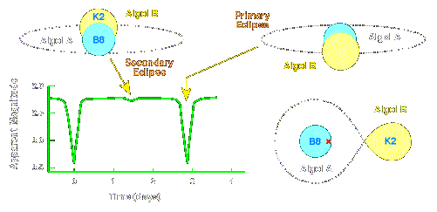
The Main Types of Variability
Eclipsing Systems
Due to a line of sight effect, we see one star of a close binary pair dim as the other blocks its light from our point of view

Slide 9
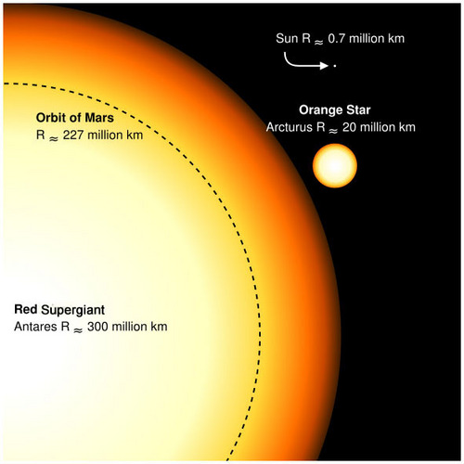
Pulsating Stars
These are generally giant stars with swollen atmospheres that actually pulse in and out as if breathing.
Some of the supergiant stars are incredibly big, hundreds of times the radius of the Sun.
The pulsations are due to instabilities in the core and atmosphere of the star.

Slide 10
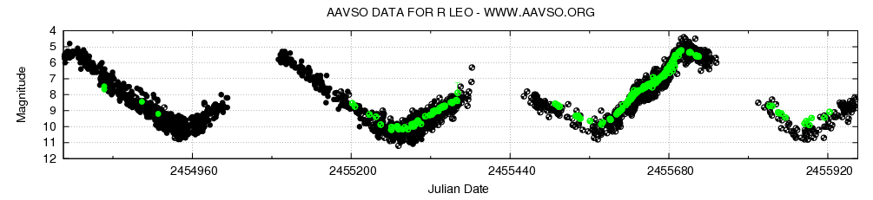
Pulsating Variable
1200 day light curve of R Leo
This pulsating red giant varies from 5th magnitude to 11th magnitude in approximately 310 days

Slide 11
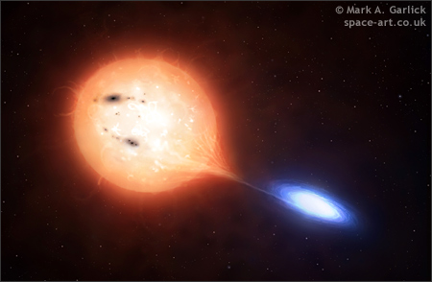
Cataclysmic Variables
Compact binary systems containing a white dwarf primary and a red dwarf secondary
The WD pulls material off the red dwarf which forms an accretion disk
When the hydrogen in the disk suddenly crashes down onto the WD tremendous amounts of energy are released at all wavelengths

Slide 12
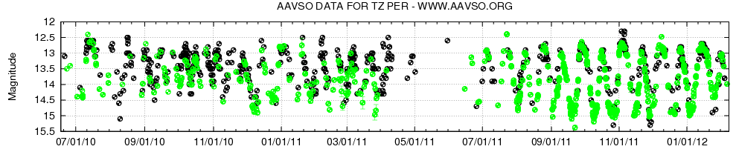
Cataclysmic Variable
600 day light curve of TZ Per
Very active cataclysmic variable with outbursts every 15-19 days

Slide 13
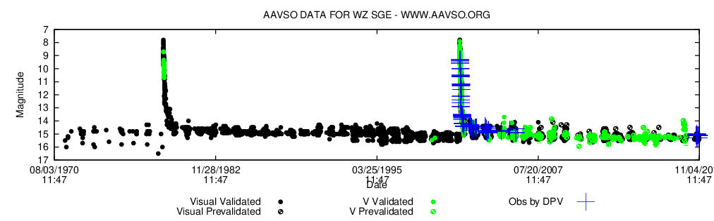
Cataclysmic Variable
600 day light curve of WZ Sge
The outburst are very rare events. The reason is low mass transfer rate.

Slide 14
Why Are Variable Stars Important?
Understanding Stellar Evolution
The Cosmic Distance Ladder
The Search For Life in the Universe

Slide 15
Stellar Evolution
Variable stars help us to understand the secret lives of stars. How they are born, live out their lives on the main sequence and then die, sometimes with a whimper and a puff of smoke, and sometimes in a violent explosion that destroys the star or leaves behind it a black hole.

Slide 16
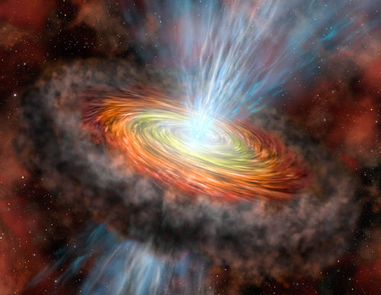
Young Stellar Objects (YSO’s)
Protostars embedded in nebulae or making nearby nebulae glow
Often associated with jets
Their light curves are usually chaotic

Slide 17
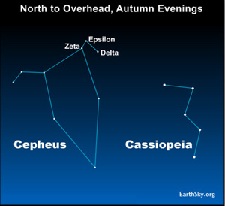
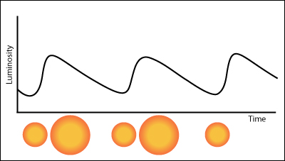
Cepheid Variables
Stars of this type form with masses of 3–30 times that of our Sun. With the hydrogen burnt up in their core, these unstable stars are now passing through later stages of nuclear burning.

Slide 18
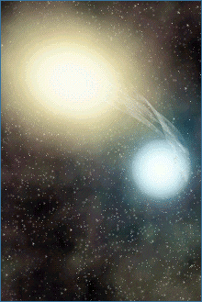
Binary Stars
Stars in close proximity to each other can influence the evolutionary development of their partner
Symbiotic variable stars and cataclysmic variables
Artists rendering of Algol

Slide 19
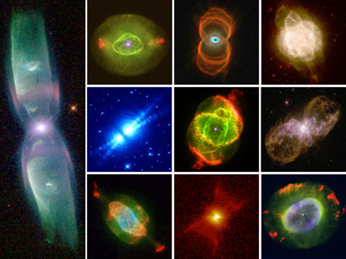
Old Age: Planetary Nebulae
Planetary nebulae are formed when a red giant star ejects its outer layers as clouds of luminescent gas, revealing the dense, hot, and tiny white dwarf star at its core.
95% of all stars that we see in our own galaxy will ultimately become "planetary nebulae". This includes the Sun.
Hubble Space Telescope images of planetary nebulae

Slide 20
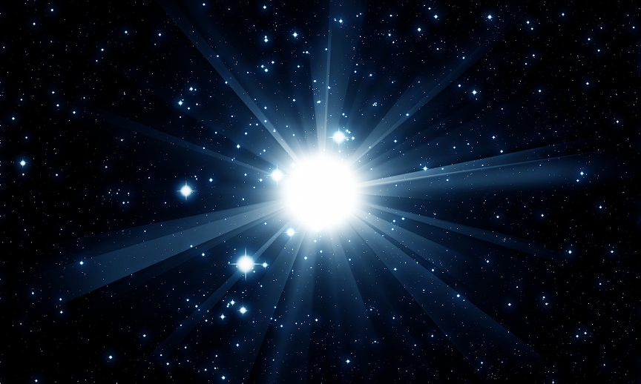
Supernovae
Supernovae are extremely luminous and cause a burst of radiation that often briefly outshines an entire galaxy.
A typical supernova can radiate as much energy as the Sun is expected to emit over its entire life span.

Slide 21
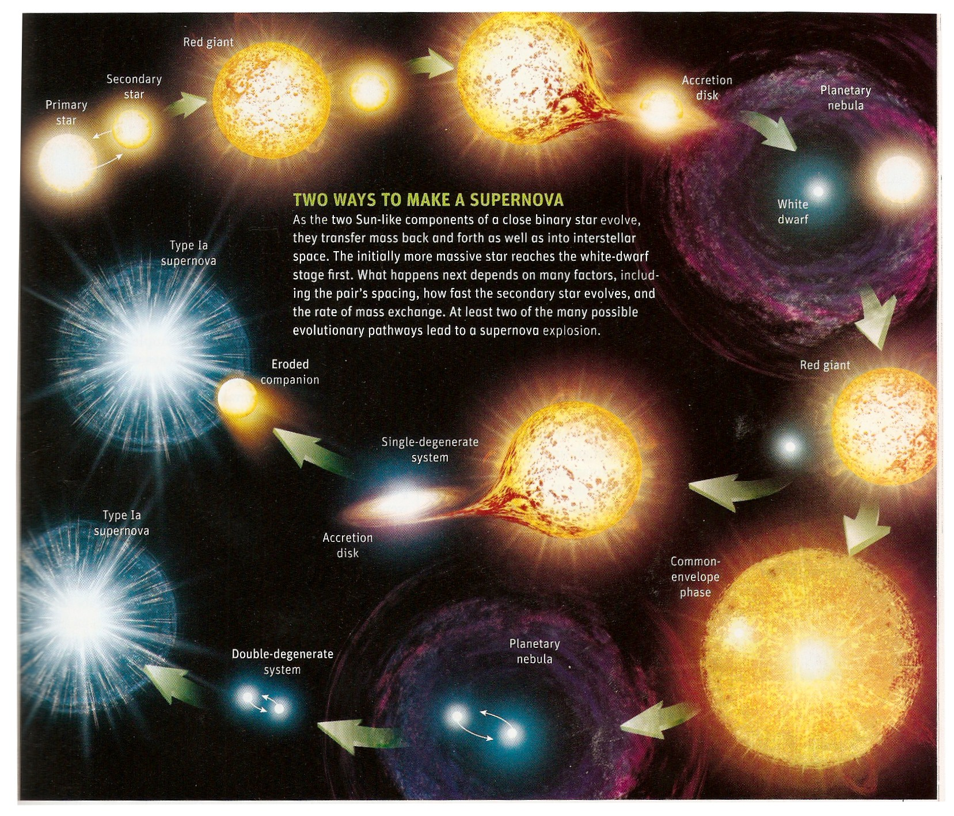
Supernovae Progenitors

Slide 22
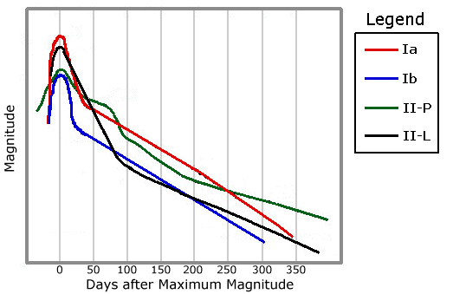
Supernovae light curves
SNe are classified by their spectra and light curves.

Slide 23
The Cosmic Distance Ladder
Our knowledge of the distance to objects in the Universe past our solar system is based almost entirely on our knowledge of variable stars. From pulsating Cepheids in the Magellanic Clouds to Type Ia Supernovae in galaxies at the edge of the known Universe.

Slide 24
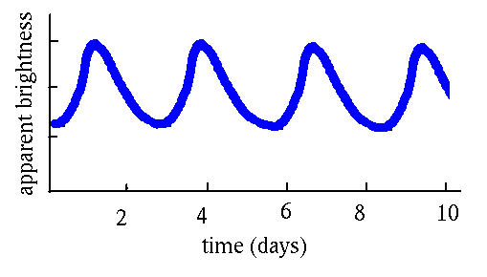
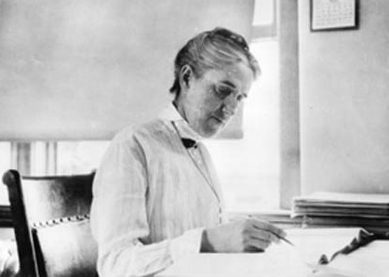
Cepheid Variables, the first “standard candles”
In 1908 Henrietta Leavitt discovered the period luminosity relationship in Cepheid variables in the Small Magellanic Cloud

Slide 25
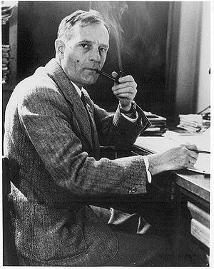
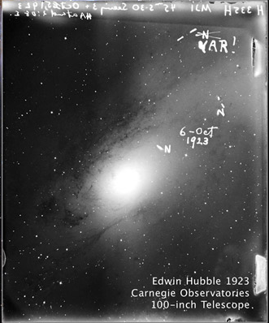
Extra-galactic variables
In 1924, Edwin Hubble used Cepheids to determine the distance to the Andromeda Galaxy, settling the island universe debate

Slide 26
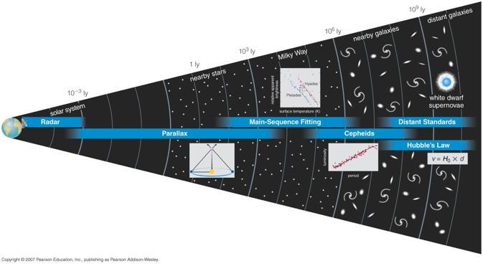
The Cosmic Distance Ladder

Slide 27
The Search For Extraterrestrial Life in the Universe
The first step, is to find earth-like planets orbiting around other stars in our galaxy.
One way to do this is to discover transiting exoplanets.
Their host stars are essentially the primary of an eclipsing binary system.

Slide 28
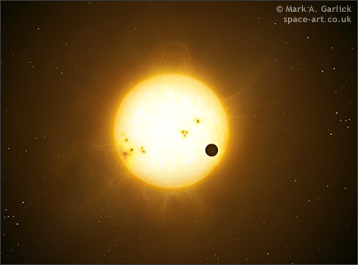
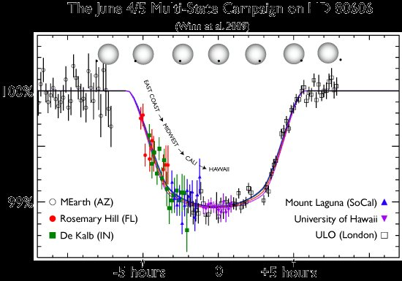
Exoplanet Eclipses
Now amateur astronomers team with professionals to detect the passage of planets in front of other stars.

Slide 29
How Can You Help?
There are literally hundreds of thousands of variable stars. Professional astronomers do not have the time or resources to observe even a fraction of them.
New surveys coming online soon will begin to discover hundreds of transient events and new objects per night.

Slide 30
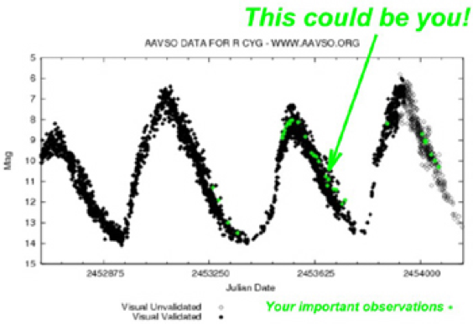
Be A Citizen Scientist
Get Involved

Slide 31
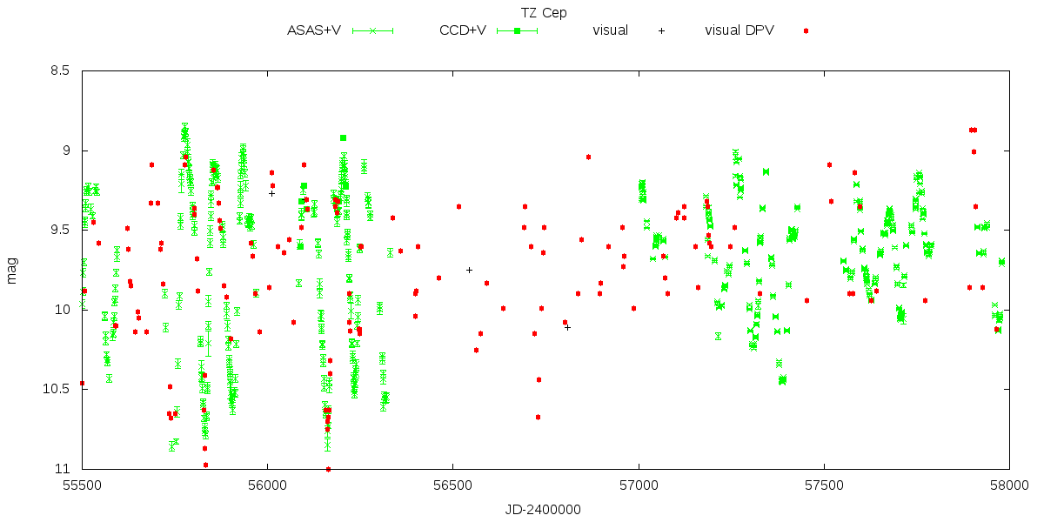
You may be the only observer of the given object on whole Earth

Slide 32
Obrigado pela sua atenção
Perguntas?
var.kozmos.sk

